Slide 1
DATA SCIENCE Class 1: Intro to Data Science

Slide 2
0. whAT Is A Data Scientist? I. How Data Scientists Add Value II. the Data SCIENCE Workflow III. Qualities of a good Data Scientist
AGENDA

Slide 3
0. whAT is A Data Scientist?
INTRO TO DATA SCIENCE

Slide 4
What Is your definition?
WHAT IS A DATA SCIENTIST?

Slide 5
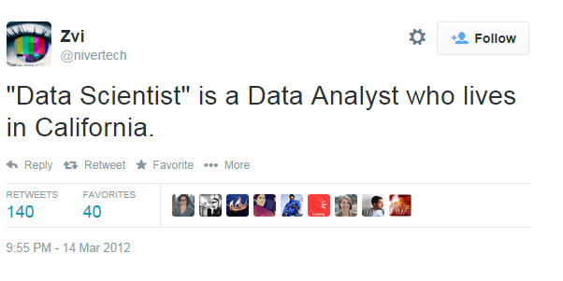
WHAT IS A DATA SCIENTIST?

Slide 6
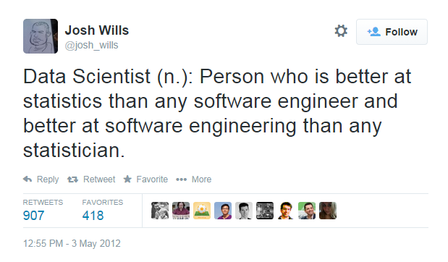
WHAT IS A DATA SCIENTIST?

Slide 7
WHAT IS A DATA SCIENTIST?
Data Scientists solve
complex problems
using data mining techniques
Problem
Domain
Computer Science
Statistics

Slide 8
WHAT IS A DATA SCIENTIST?
Wide variance in terms of skillsets: many job descriptions are more appropriate for a team of data scientists
Data Scientists solve
complex problems
using data mining techniques
Problem
Domain
Computer Science
Statistics

Slide 9
I. How Data Scientists Add Value
INTRO TO DATA SCIENCE

Slide 10
HOW DATA SCIENTISTS ADD VALUE
Data mining techniques generally add value by doing one of four things:
Predicting the bad
Identifying the good
Automating existing processes
Data scientists can be found within many fields: let’s look at some additional examples to motivate this course.
Source: https://www.youtube.com/watch?v=fPzmnRj671Y

Slide 11
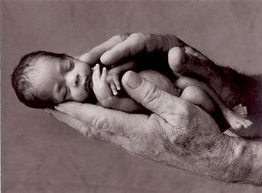
Example #1: Predicting Neonatal Infection
Problem: Children born prematurely are at high risk of developing infections, many of which are not detected until after the baby is sick
Goal: Detect subtle patterns in the data that predicts infection before it occurs
Data: 16 vital signs such as heart rate, respiration rate, blood pressure, etc…
Impact: Model is able to predict the onset of infection 24 hours before the traditional symptoms of infection appear
Image: http://www.babycaretips4u.com/wp-content/uploads/2014/03/premature-baby.jpg
Case Study: http://www.amazon.com/Big-Data-Revolution-Transform-Think/dp/0544002695

Slide 12

Example #2: Automating Government Paper-Pushing
Problem: Processing disability claims at the Social Security Administration is a time-intensive process, with many claims taking over 2 years to adjudicate
Goal: Automate the approval of a subset of the “simplest” disability claims
Data: Free text in the claims form
Impact: Able to fully automate 20% of the simplest claims. Rating accuracy of the algorithm is higher than the average claims examiner.
Case Study: http://datamininglab.com/images/case-studies/ERI_Text_Mining_SSA_Claims_for_Disability_Approval.pdf

Slide 13
Ii. the data SCIENCE workflow
INTRO TO DATA SCIENCE

Slide 14
The data Science WORKFLOW
0. Define the problem / question
I. Identify and collect data
II. Explore and prepare data
III. Build and evaluate model
IV. Communicate results

Slide 15
0. Define the Problem / Question
THE DATA SCIENCE WORKFLOW
Can I predict infection before it occurs?
Can I predict claim approval from the start of the process?

Slide 16
I. IDENTIFY AND COLLECT DATA
THE DATA SCIENCE WORKFLOW
Vital Areas: Heart Rate, Blood Pressure, etc…
Want to collect all data on the claim form (mostly free text)

Slide 17
II. EXPLORE AND PREPARE DATA
THE DATA SCIENCE WORKFLOW
Aggregate data at the minute level
Cluster like words

Slide 18
III. BUILD AND EVALUATE Models
THE DATA SCIENCE WORKFLOW
Compare Decision Tree with Logistic Regression
Start with Naïve Bayes Classifier

Slide 19
IV. COMMUNICATE RESULTS
THE DATA SCIENCE WORKFLOW
Create custom dashboard for doctors and nurses
Create report and dashboard proof of concept

Slide 20
III. Qualities of a good data scientist
INTRO TO DATA SCIENCE

Slide 21
Communicates Clearly
Qualities of a good data scientist

Slide 22
Understands the pros & cons of different techniques
Qualities of a good data scientist

Slide 23
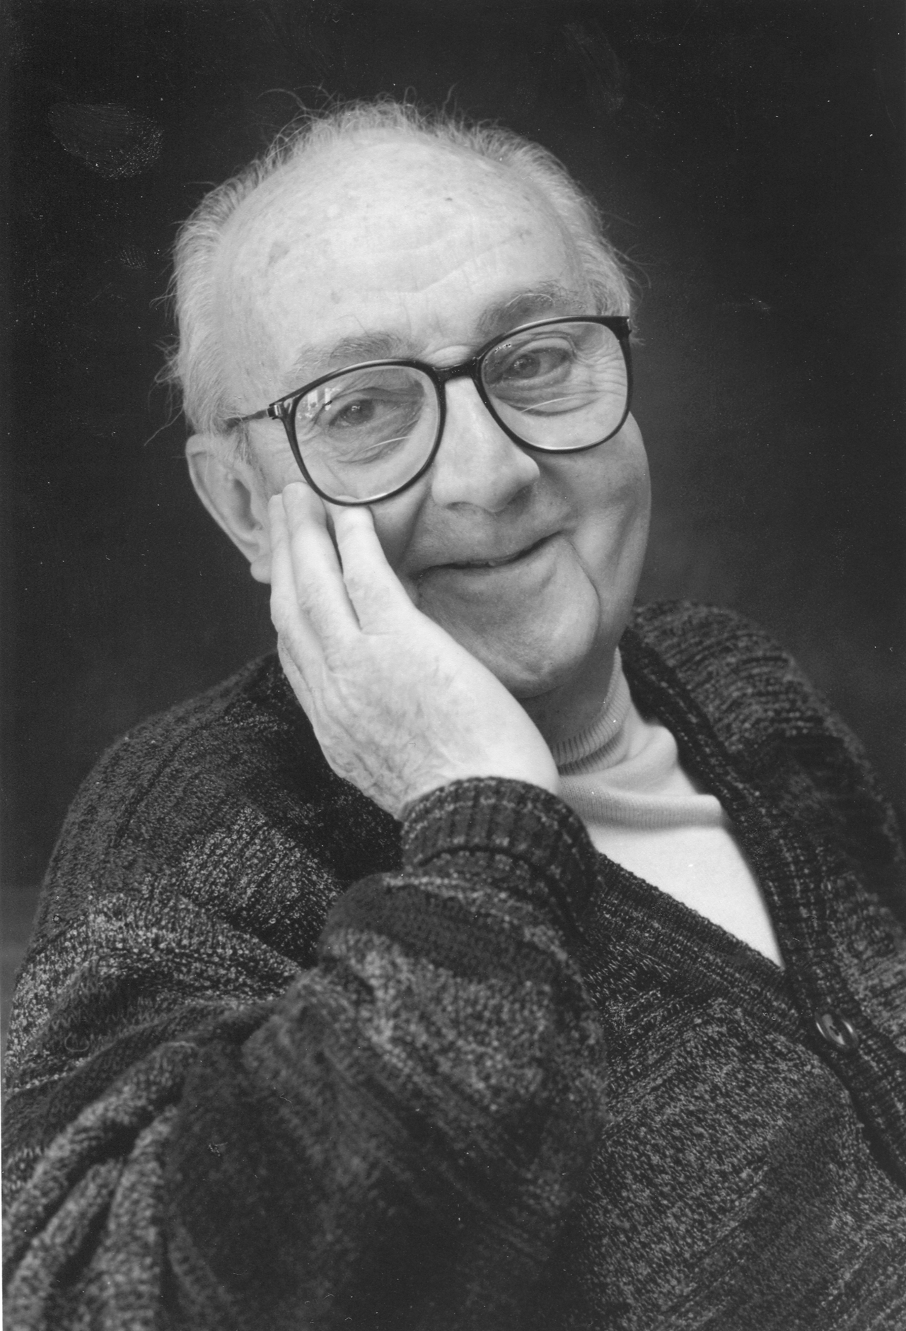
STATISTICIANS, LIKE ARTISTS, have the bad habit of falling in love with their models - George Box
Qualities of a good data scientist

Slide 24
Retains Intellectual Humility
Qualities of a good data scientist
Problem
Domain
Computer Science
Statistics
Notes:
There is always something to learn – humility helps you to learn from others

Slide 25
Asks Rational Questions
Qualities of a good data scientist
Notes:
As demonstrated by Nobel Laureate Daniel Kahneman, it can be quite difficult to think rationally.

Slide 26
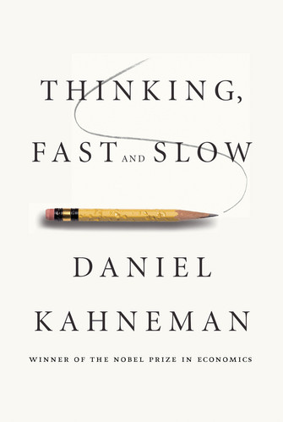
Qualities of a good data scientist
As demonstrated by Nobel Laureate Daniel Kahneman, it can be difficult to think rationally.
The Hindsight Illusion
Law of Small Numbers
The Anchoring Effect

